Slide 1
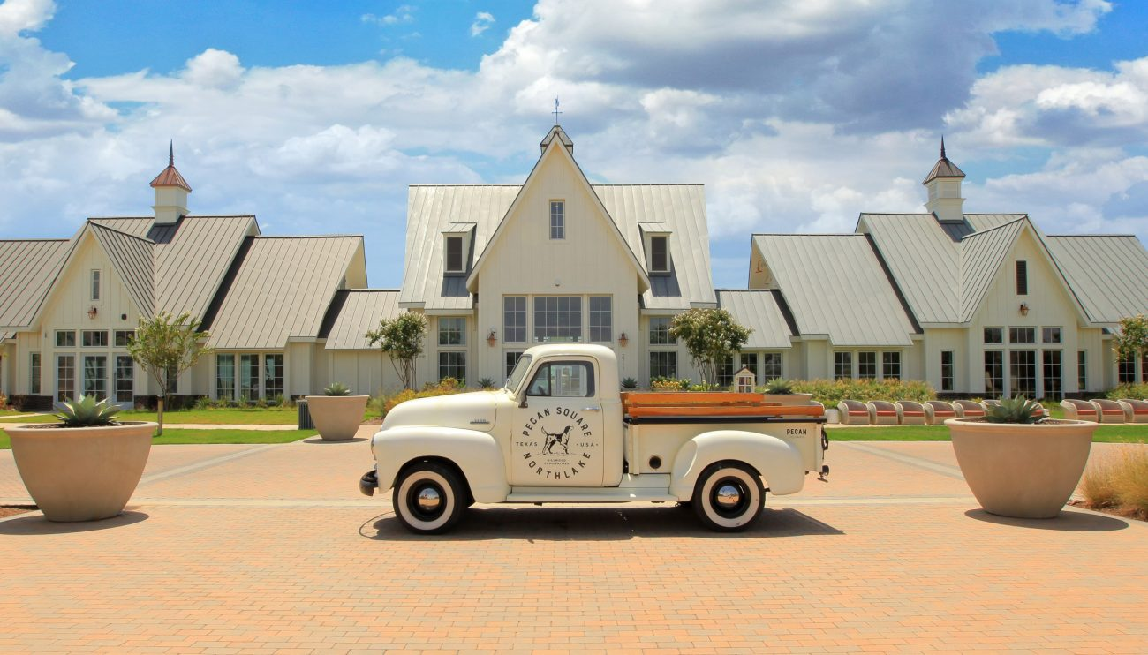
PECAN SQUARE HOA ANNUAL MEETING

Slide 2
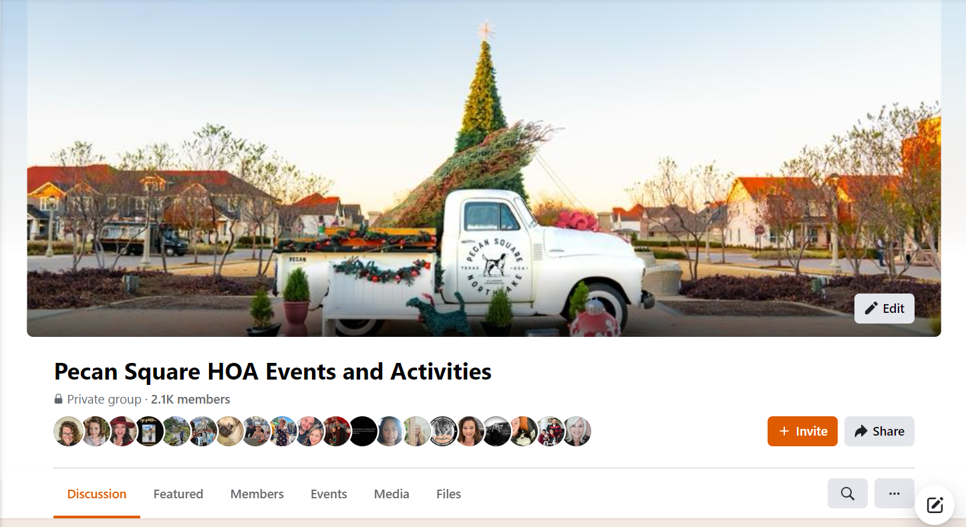
STAY CONNECTED
Pecan Square Life App
Event details, reservations,
and reminders
Amenity rental reservations
Pecan Square HOA Events & Activities
Events details and reminders
LIVE videos to make sure you don’t
miss anything

Slide 3
AGENDA
Welcome!
Introductions
Presentation by Northlake PD.
Manna Drone Delivery Update
Management Report
Who does what?
2023-2024 Budget
Lifestyle Report
Review
Looking Ahead
Developer Report
Questions
Adjourn

Slide 4
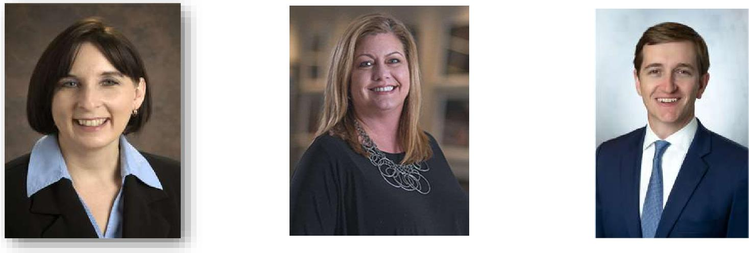
INTRODUCTIONS
Board of Directors
Kim Comiskey Angie Mastrocola Andrew Pieper
President Vice President Secretary/Treasurer

Slide 5
INTRODUCTIONS
Management Team
Mark Pacheco
General Manager
Christopher Gruber
Assistant General Manager HOA
Razeena Sanchez
Lifestyle Manager
Heather Swartwood
Community Host
Brandon Yeager Porter
Tanya Mendenhall
Vice President-Developer
Relations

Slide 6
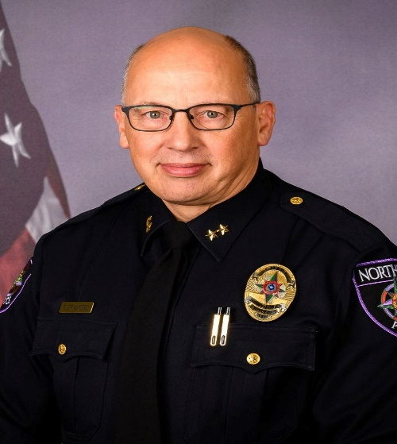
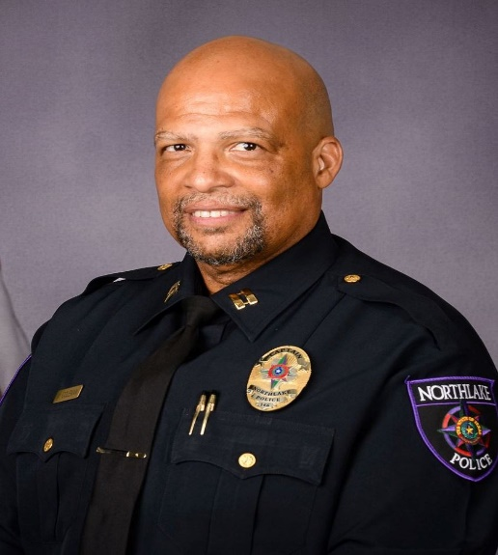
NORTHLAKE POLICE DEPARTMENT
Robert Crawford
Northlake Chief of Police
rcrawford@town.northlake.tx.us
Michael Coleman
Captain
mcoleman@town.northlake.tx.us
Alex Arnold
Criminal Investigations Sergeant
aarnold@town.northlake.tx.us
Dwight Thornton
Sergeant
dthornton@town.northlake.tx.us
Daniel Hansen
Sergeant
dhansen@town.northlake.tx.us
Micah Hayman
Sergeant
mhayman@town.northlake.tx.us
Doug Williams
Sergeant
dwilliams@town.northlake.tx.us

Slide 7
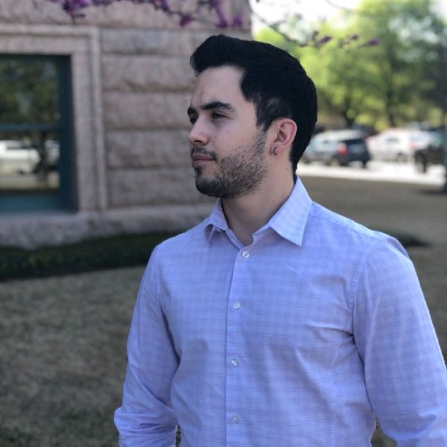
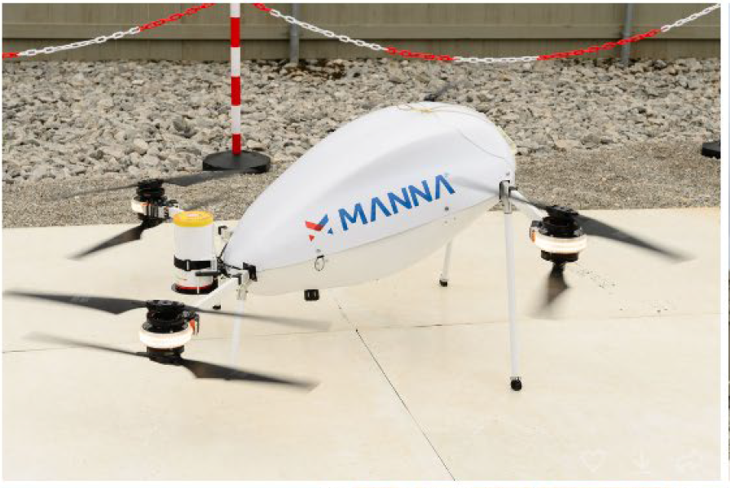
MANNA DRONE DELIVERY
Cristian Maury - US Project Manager

Slide 8
PURPOSE AND BENEFIT OF THE HOA
Homeowner Rights:
Use of Common Facilities
Expect HOA to be managed per the Governing Documents
Protect and Enhance Property Values
CC&R Compliance
Architectural Review
Maintenance of Common Areas
Jackson Hall, Greeting House, Swimming Pool, Arena
Streetscapes and ROW’s
Parks, Greenbelts and Entry Features
Provide Programming and Lifestyle to Enhance Quality of Life and Promote a Sense of Community
Homeowner Obligations:
Pay Assessments
Comply with Governing Documents; Rules and Regulations
Support Community Living

Slide 9
Emergency Preparedness Commitee
The EPC is a resident ran and resident staffed Committee.
Since its start in 2022 it has grown from a committee member of 1 to 9 committee members and 50 other volunteers.
They have held two CPR class’s that 35 residents and staff have attended in 2023.
They have held tornado safety, winter preparedness, and two children’s preparedness classes in 2023.
They have been part of National Night Out and participate in New Homeowner Orientation each month.
They were the organization that helped push for the AED stations in the community.
They have scheduled for 2024:
Another tornado class for 02/20/2024
Stop the Bleed class.
Winter Preparedness class.
Fire safety class for kids.
And three more CPR classes.
Information about joining the EPC can be found on the Pecan Square HOA web site at:
www.pecansquarehoa.com or scan the QR code that was given tonight by the EPC committee.

Slide 10
WHO DOES WHAT?
WHO IS THE DEVELOPER?
Plans the layout and design elements
Installs infrastructure
Forms the Association (Declarant)
Works with legal counsel to create governing rules and guidelines
WHO IS ON THE BOARD AND WHAT IS THEIR ROLE?
Representatives of the Declarant currently
Approval of budgets & contracts
Determines assessment rates
Establishes committees
Initially serves or appoints the Architectural Committee
WHAT IS THE MANAGEMENT COMPANY’S ROLE?
Carry out decisions made by the Board
Provide information, training, and leadership on the Association’s operations to the Board and the community.
Resident liaison
Accounts payable & receivable Coordination with Vendors
Budget preparation for Board approval CC&R enforcement
Meeting facilitation

Slide 11
2023 ACCOMPLISHMENTS AND 2024 PROJECTS
Just a handful of 2023 Accomplishments Just a handful of 2024 Projects
New Equipment for the gym Reseal arena wood inside and out
Pioneer Park turf serviced New Pool Table
Deep clean of both the Greeting House and Jackson Hall Contracted to have windows cleaned at Jackson Hall and Greeting House
Repairs to Fire Pit Contracted to have doghouse and barn doors at arena painted
Resurfacing of Sport court Contracted to have pool coping repaired as well as pool deck
Repairs to Pecan Truck Contracted to have cabanas painted at the original pool
Weekly Violation drives Working on collecting bids for lights at dog park
Weekly landscape drives Working with the developer on the new Pickleball facility
Grills scheduled and cleaned every quarter Working with the developer on the new Pool facility
Pressure washing of pool decks We will be purchasing new chairs for Jackson Hall rental room.
Misc. repairs to dog park and other parks Sending Pecan Truck out to be restored
Locks installed at Greeting house and Jackson Hall Scheduling repairs on North Pecan, Elm and Jack Rabbit park to repair lights
Fan repaired inside Jackson Hall Scheduling repairs to lights at Fielding Park
Contracted with AED service for machines located in the community Scheduling repairs to arena lights

Slide 12
BUDGET COMPARISON 2023-2024
Category | 2023 Actuals | 2024 Budget
Assessment & Operating | $3,999,292 | $5,332,020
Utility Expense | $1,079,782 | $1,928,635
Landscape Maintenance Expense | $1,171,556 | $1,542,675
Common Area Maintenance Expense | $111,238 | $114,000
General & Administrative Expenses | $224,003 | $208,908
Amenity Center/Pool Maintenance Expense | $315,634 | $330,550
Committee Budgets Expenses | $131,223 | $146,000
Insurance and Taxes Expense | $54,964 | $99,410
Onsite Management | $603,482 | $770,000
Reserve Fund | 176,932 | $191,842
TRrrrrr
Total Expenses | $3,868,814 | $5,332,020
Operating Net Income/(Loss) | $130,479 | $0

Slide 13
RESERVE FUND
What is a Reserve Fund?
A reserve fund is a designated sum of money set aside for future major expenses, such as building repairs or replacements. A reserve study was completed in 2023 that estimated the amount of reserve funds that are needed annually. The reserve study will be updated at the end of 2024 after several new amenities and common areas are completed this year. It is important to have a healthy reserve fund to prevent unexpected financial burdens on individual homeowners.
Reserve fund balance as of 01.01.2023: $250,000
Budgeted Funds transferred to reserve on 12.31.2023 $176,932
Total Reserve Funds on 12.31.2023 $426,932 Additional cash on hand approved for transfer by Board $300,000
Total Reserve Fund Balance $726,932
2024 Budgeted Reserve Funds for transfer $191,842
Total Projected reserve fund balance on 12.31.2024 $918,774

Slide 14
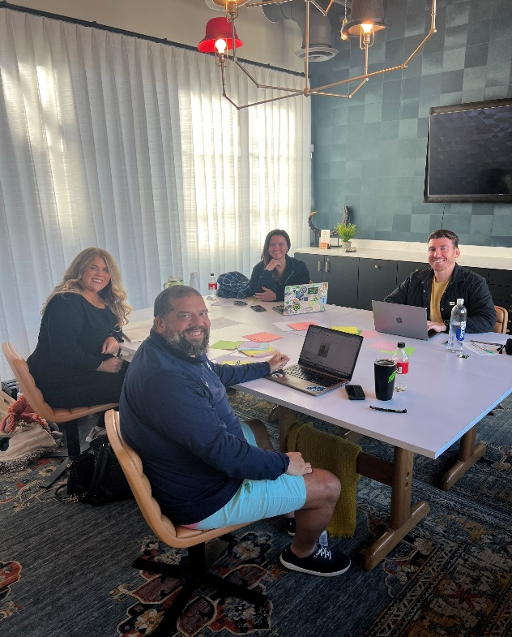
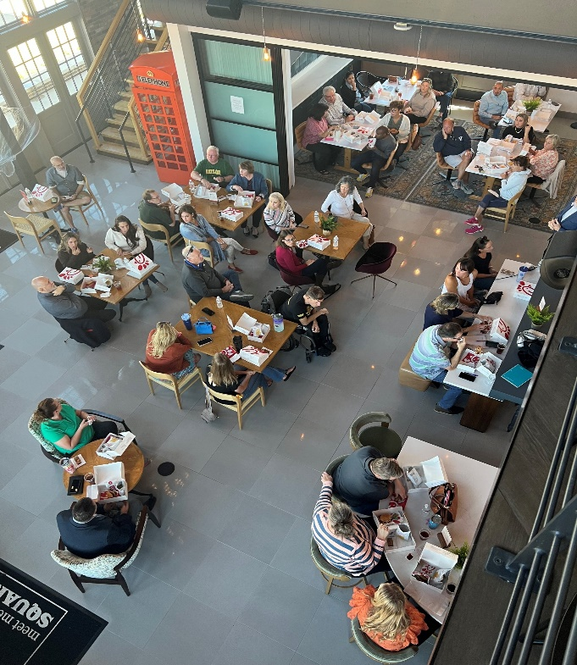
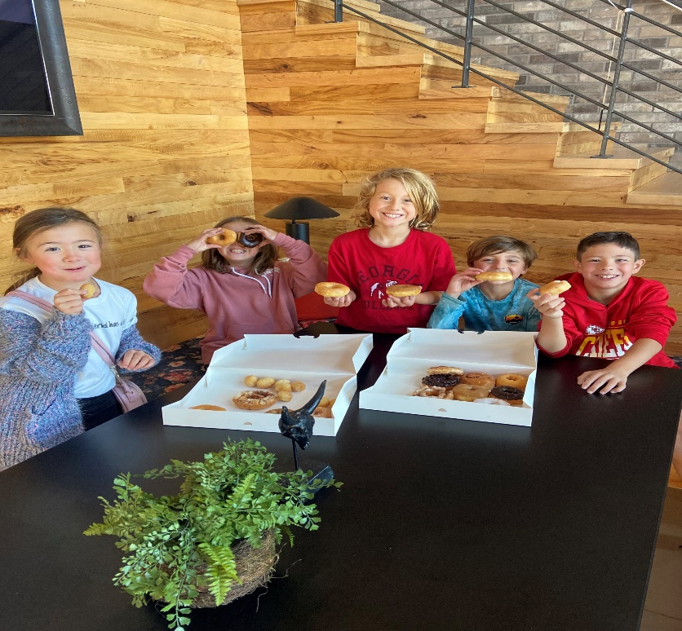
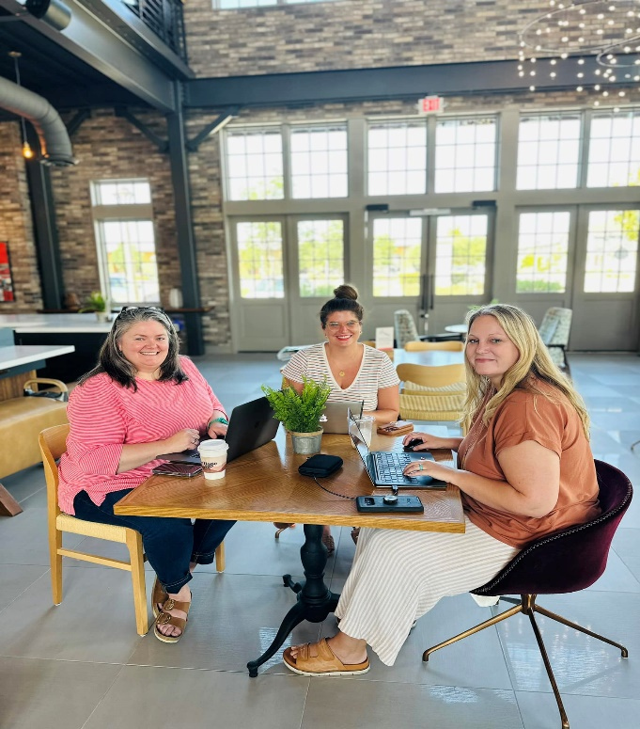
THE GREETING HOUSE
Open 7 days a week
HOA staff on site
Amenity tours
High speed internet
Additional monitors available
Jack’s Snacks
Pecan Square merchandise
Conference room / rental space reservations
Amenity Tours
Printing & Scanning capabilities
Workroom space perfect for craft projects
Resident advertising space
Monthly coworking treats
Quarterly lunch & learns
Heather Swartwood
Heather.swartwood@fsresidential.com Admin Number: 214.591.3201

Slide 15
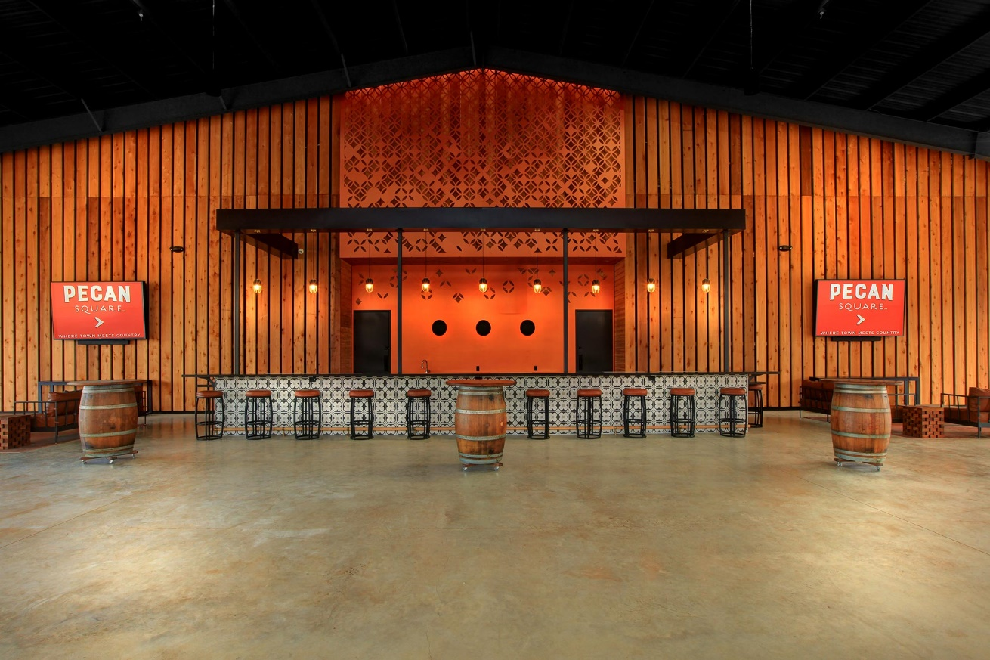
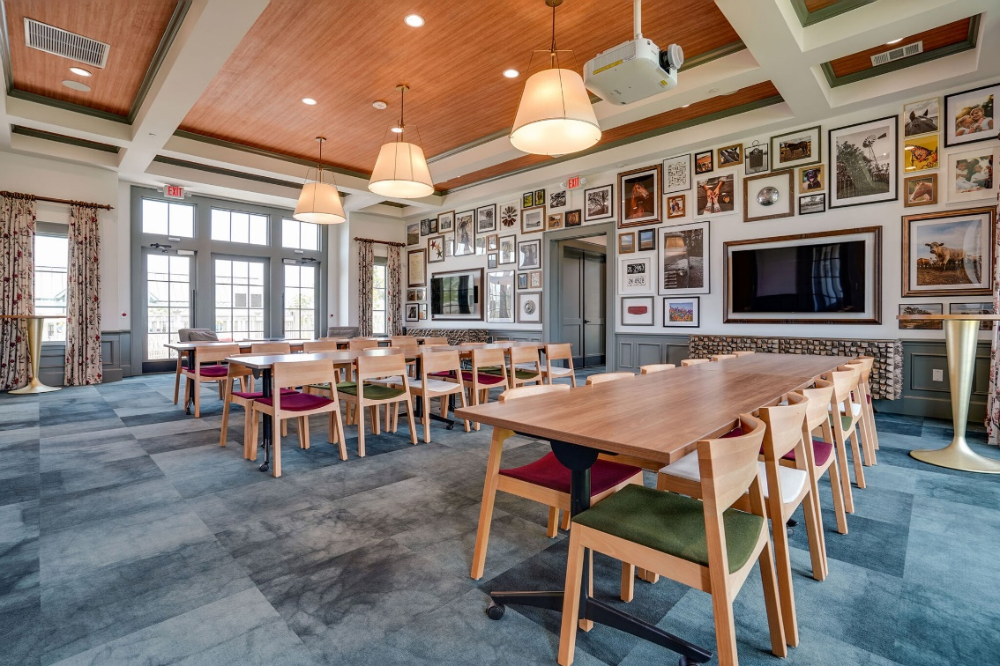
RENTAL SPACES WITHIN PECAN SQUARE
Jackson Hall family room, Greeting House & entertainment side of Arena
Reserved thru the Pecan Square Life app, about to book 60 days out.
Birthday parties, baby showers, weddings & anniversary parties.

Slide 16
LIFESTYLE AT PECAN SQUARE

Slide 17
LIFESTYLE AT PECAN SQUARE
The Lifestyle Program at Pecan Square is so much more than just events— it’s getting to know residents on a personal level and walking with them through both the good and bad times. The Lifestyle Program provides opportunities for learning, growth, and support, which can enrich the lives of our residents personally and professionally.
Hosted over 275 events and activities.
Provided over 60,000 meals to the North Texas Food Bank and the Tarrant Area Food Bank this year.
Partnered up with Johnie R. Daniel Elementary to co host events.
Brought new food trucks into Pecan Square.

Slide 18
LIFESTYLE AT PECAN SQUARE
LOOKING FORWARD TO 2024
Silent Disco
Adult Prom Night
Kids Talent Show
Health and Wellness Classes

Slide 19
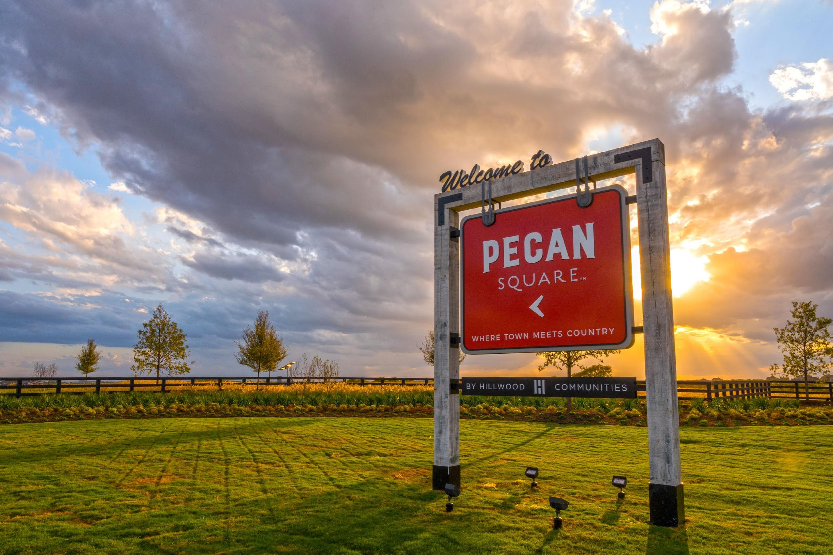
DEVELOPER UPDATE

Slide 20
SALES AND CLOSINGS
 | 2019 | 2020 | 2021 | 2022 | 2023 | Total
Sales | 130 | 476 | 478 | 147 | 401 | 1,631
Closings | 32 | 402 | 366 | 371 | 236 | 1,407
Avg. Sale Price | $345K | $354K | $453K | $583K | $552K | $461K
Avg. Home Size | 2,446 | 2,452 | 2,547 | $2,639 | 2,728 | 2,564

Slide 21
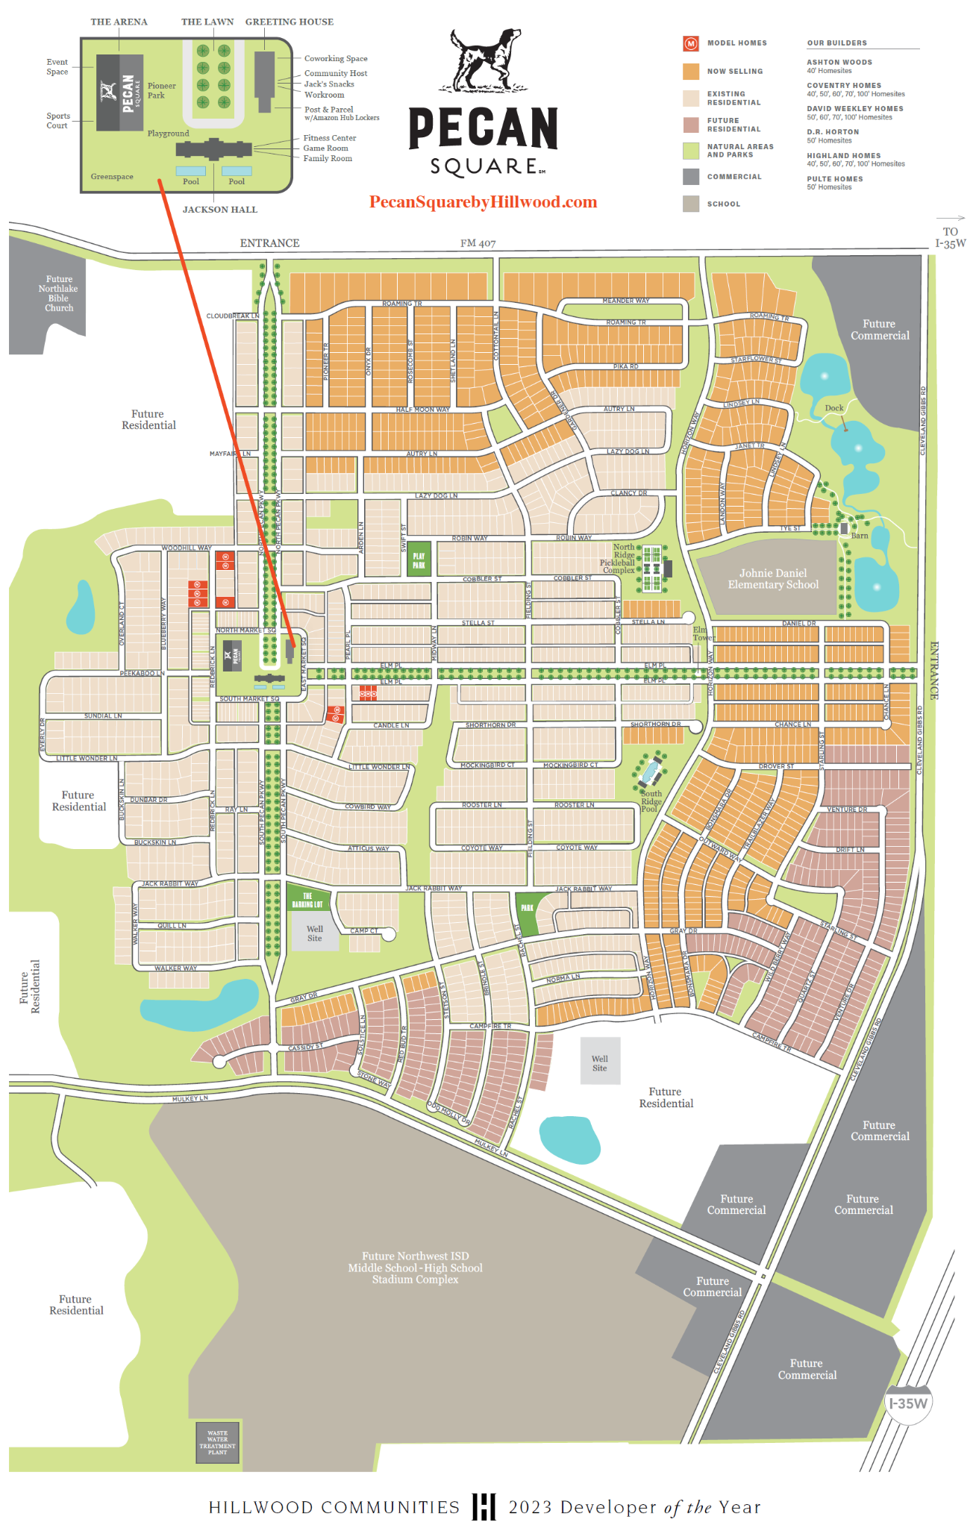
COMPLETED LOTS
Phase 1 – 675 Lots
Phase 2 – 716 Lots
Phase 3A/C – 466 Lots
Phase 4C - 254 Lots
Sub-Total – 2,111 Lots
LOTS UNDER CONSTRUCTION
Phase 3B – 131 Lots (3Q24 Completion)
Phase 4A – 199 Lots (4Q24 Completion)
Sub-Total –330 Lots
Total – 2,441
Phase 4B – 184 Lots (In Design)

Slide 22
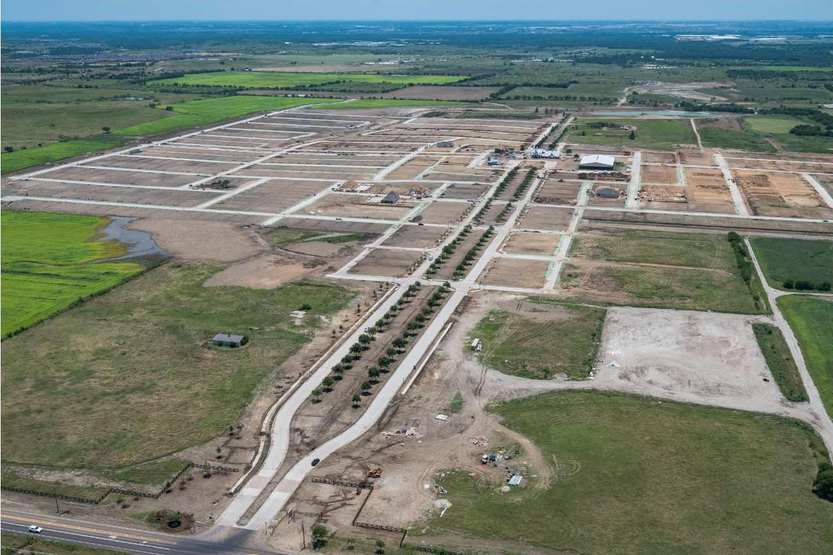
July
2019

Slide 23
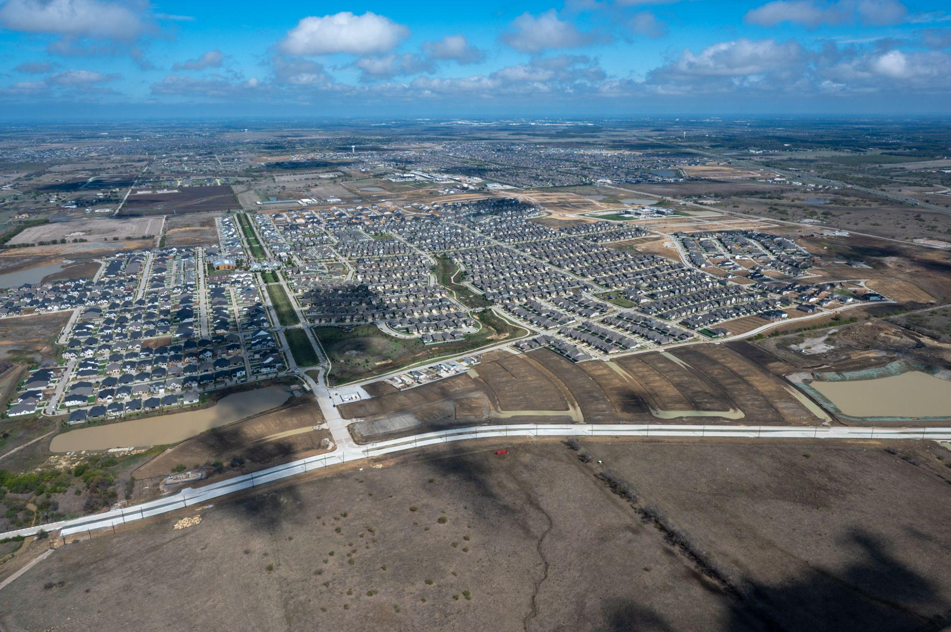
December
2023

Slide 24
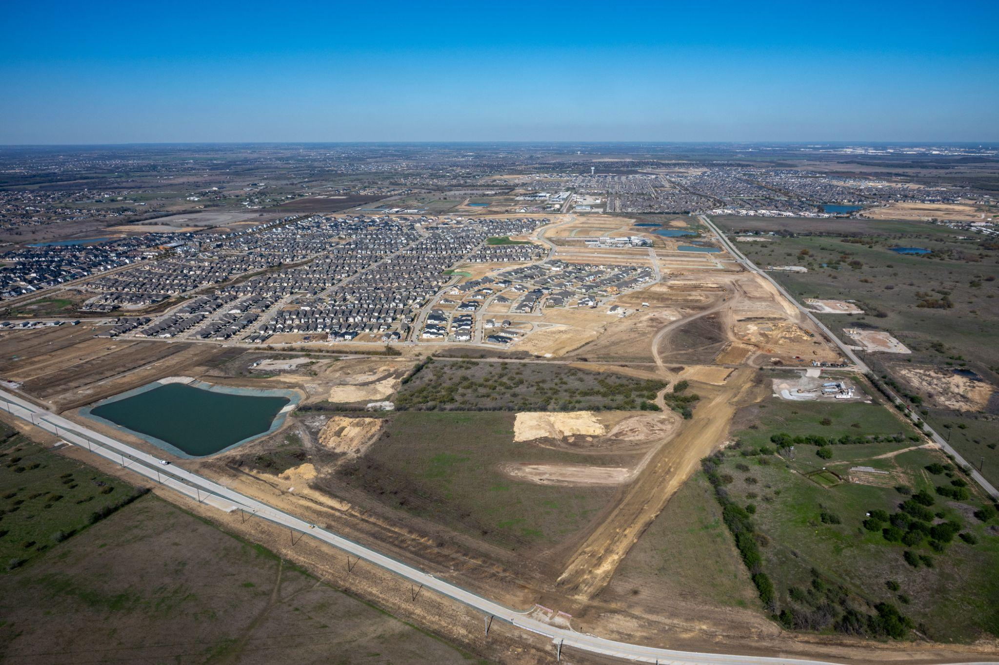
December
2023
Cleveland Gibbs New Alignment

Slide 25
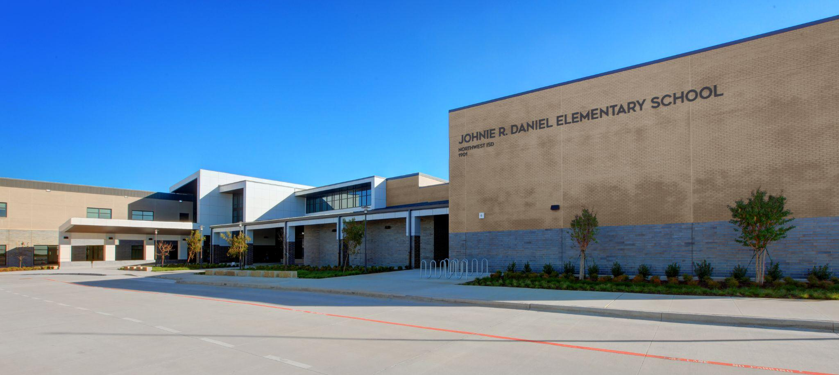
Opened Fall 2023
Daniel Dogs
Dr. Jessica McDonald, Principal
Johnie R. Daniel Elementary School

Slide 26
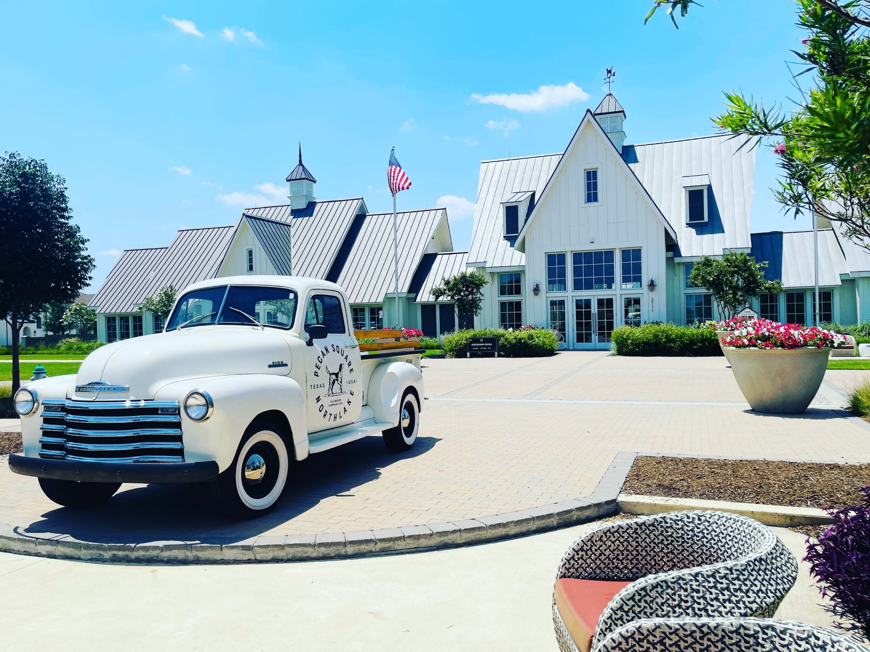
PECAN SQUARE AMENITY UPDATE

Slide 27
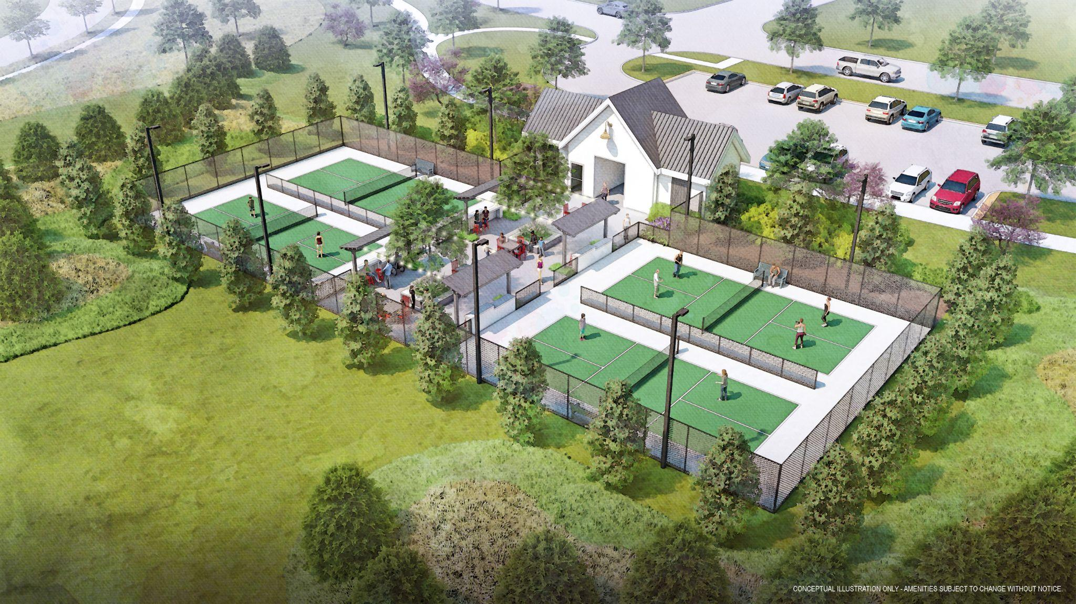
North Ridge - Pickleball Complex
37

Slide 28
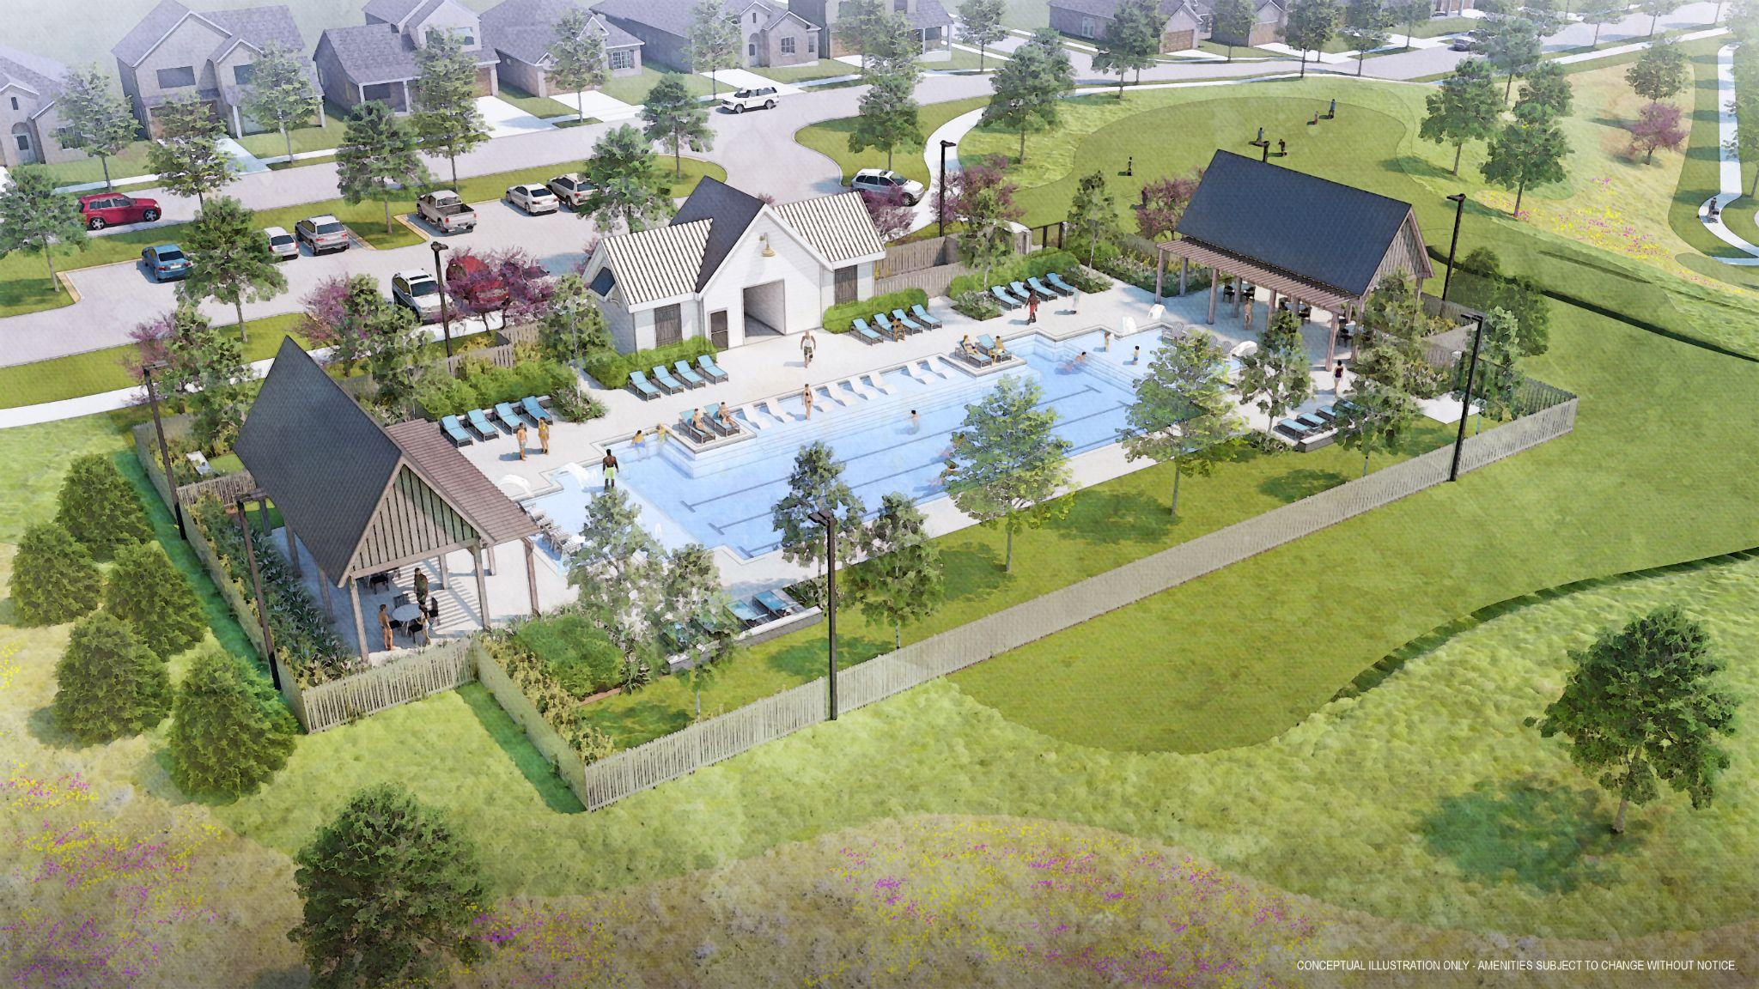
South Ridge - Amenity Center
37

Slide 29
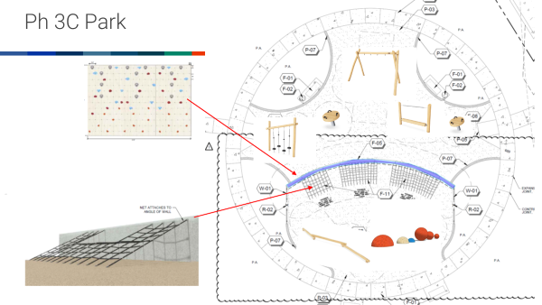
Pocket Park

Slide 30
Questions?

Slide 31
Thank you for joining us.

