Slide 1
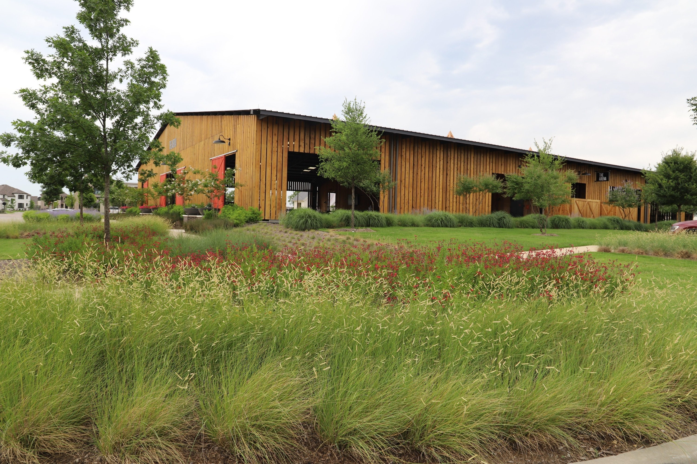
Optimizing Your Spring & Summer Landscape: Expert Tips for Success

Slide 2
Selecting the Right Plants
Choosing the for your spring and summer landscape is crucial. Consider factors such as sunlight exposure, soil type, and
. Opt for a diverse selection of ﬂowering and foliage plants to create a visually captivating and sustainable landscape.

Slide 3
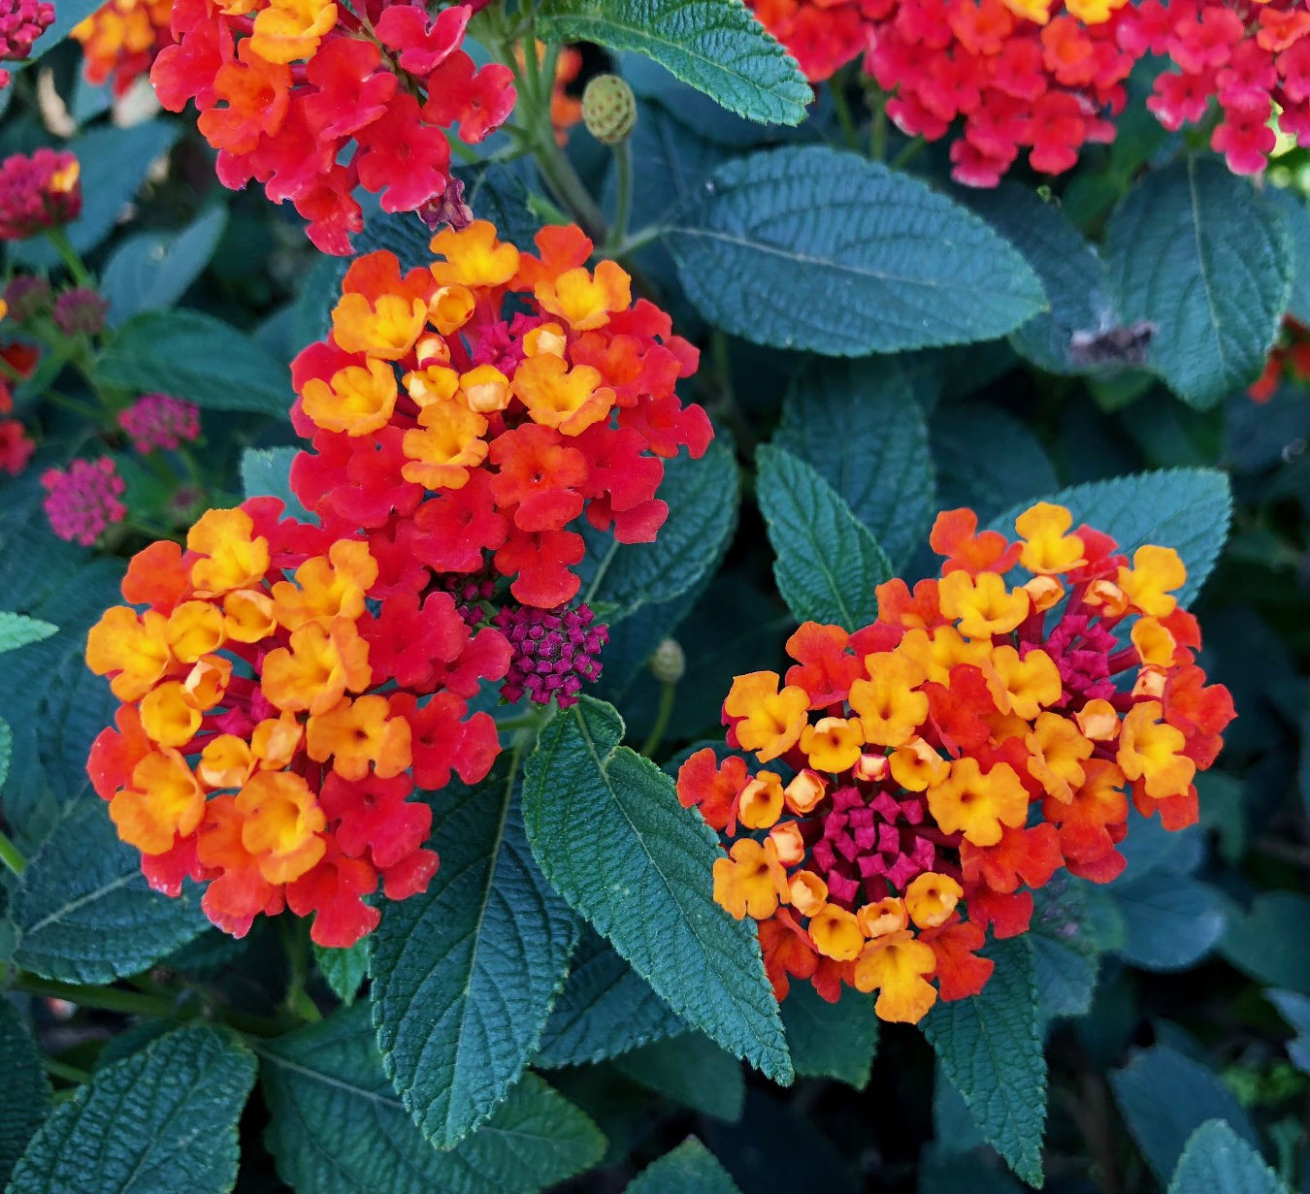
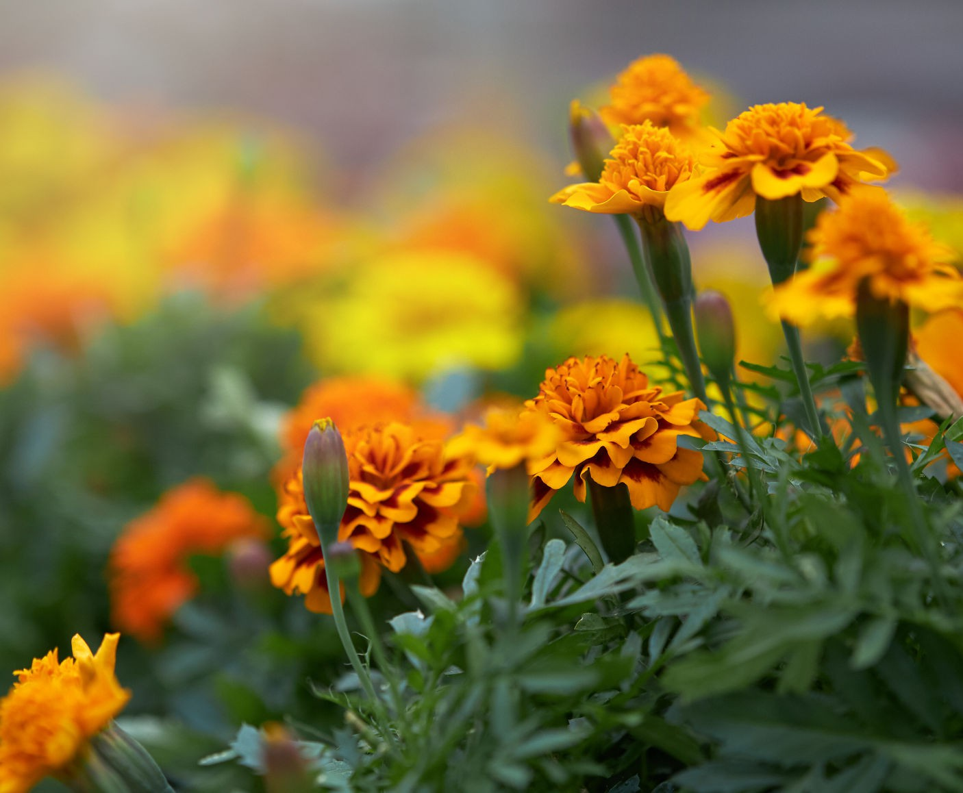
Texas- Tough Plants
Texas red lantana Purple fountain grass Angelonia
Sweet potato vine Coleus
Red yucca Caladiums
Salvia
Mexican bush sage Cora vinca XDR Zinnias
Marigolds
Impatiens Begonias

Slide 4
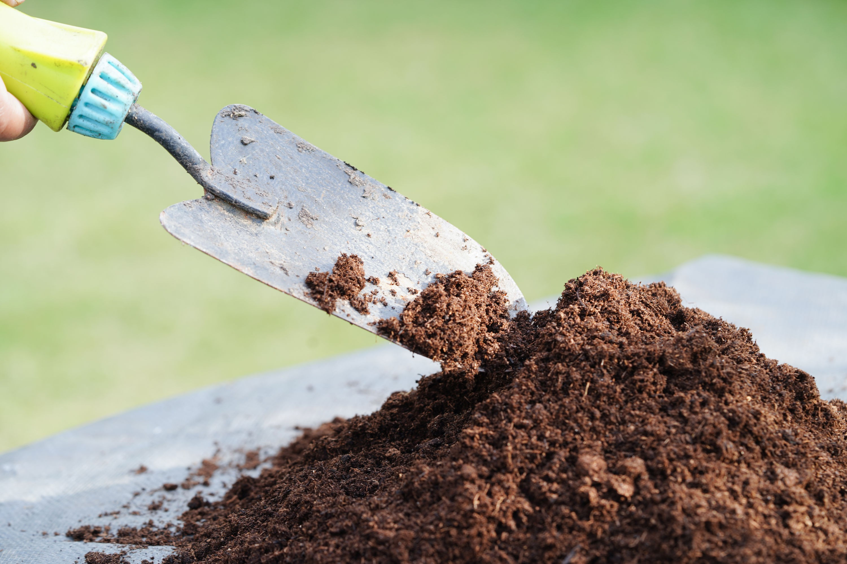
Prepping the Soil
Preparing the soil is a fundamental step for a successful landscapes. Utilize
and mulch to enrich the soil and enhance its water retention and nutrient levels. Proper soil preparation is key to fostering healthy and robust plant growth.

Slide 5
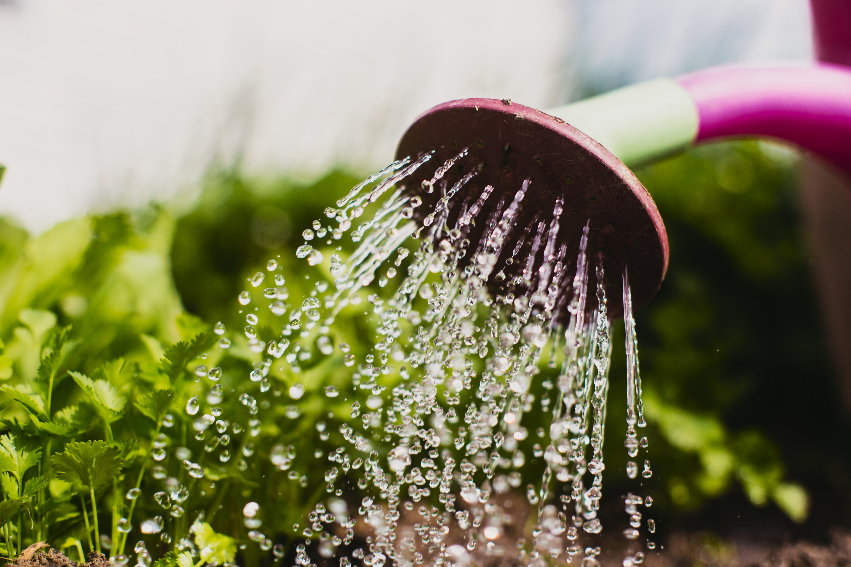
Effective Watering Strategies
Implementing
practices is essential for maintaining a thriving landscape. Utilize a combination of manual watering and
systems to ensure that plants receive adequate moisture without wastage. Consistent and targeted watering promotes healthy root development and plant vitality.

Slide 6
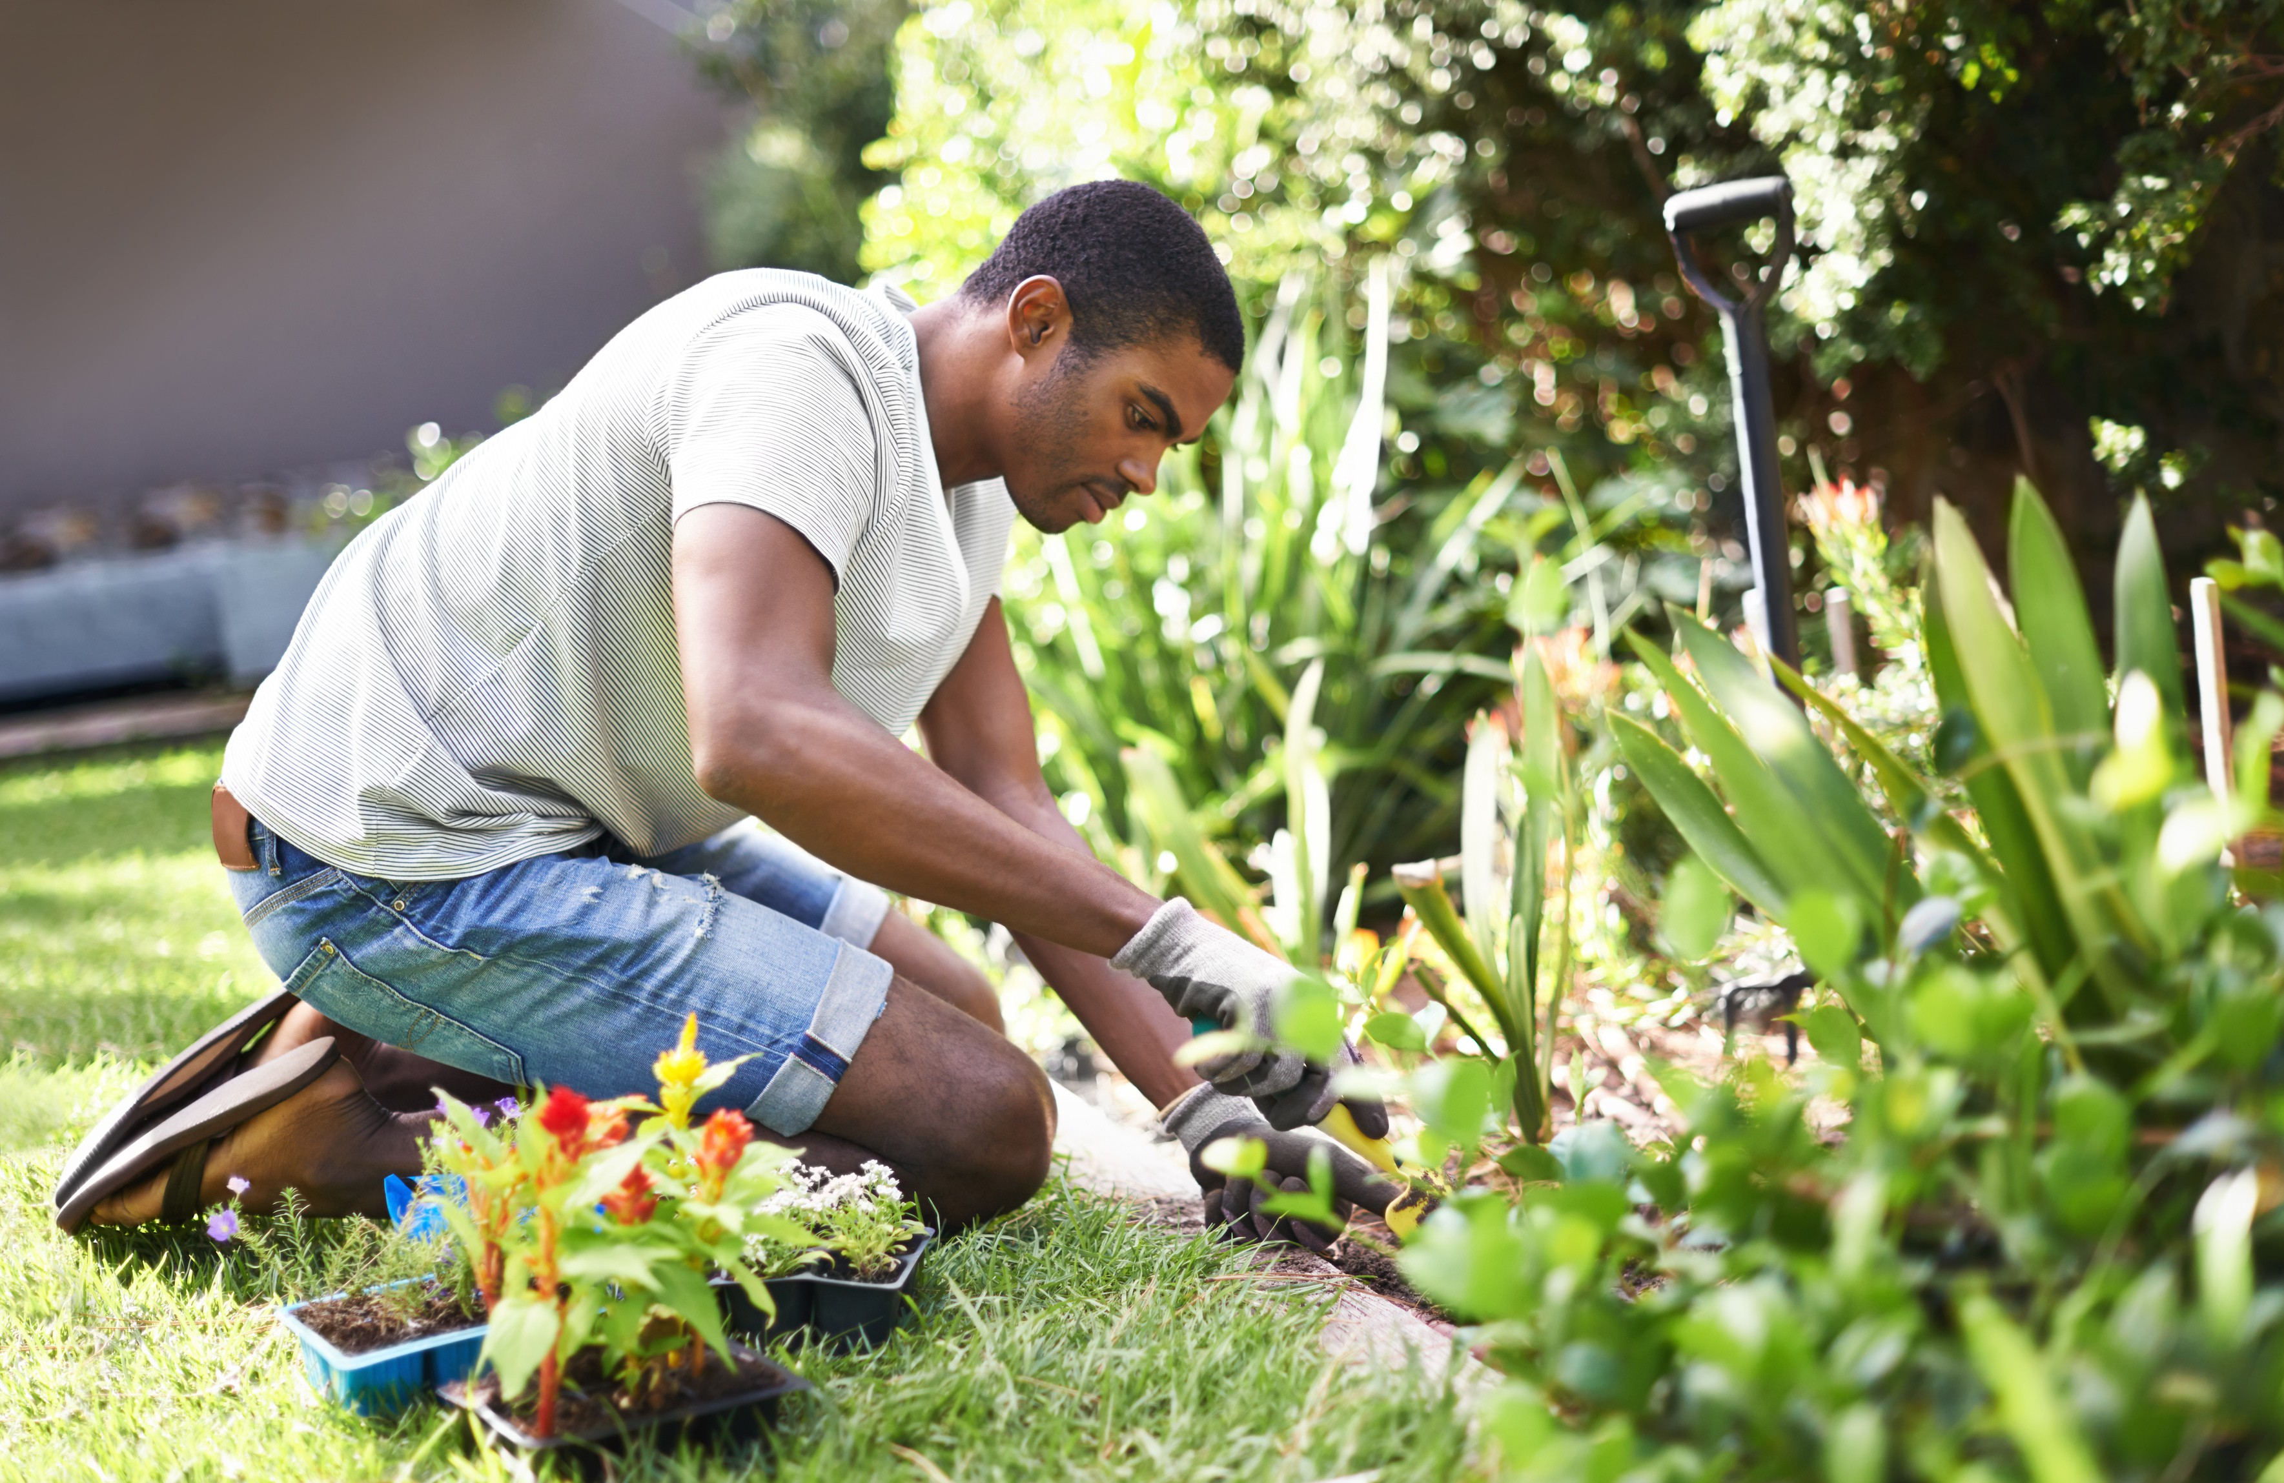
Seasonal Maintenance Tips
Regular maintenance is crucial for preserving the beauty and health of your landscape. This
includes tasks such as weeding, and
staying proactive with
,
. By
maintenance, you can ensure that your landscape remains vibrant and ﬂourishing throughout the season.

Slide 7
Thanks!

